Slide 1
<Container Security Scanning Service>
Requirements and analysis model

Slide 2
Product description
To enhance the security of DevOps and MLOps, we are going to develop a container scanning service which can integrate into the CI/CD pipeline of DevOps and MLOps. Container scanning refers to analyzing the contents and build process of container images to detect security issues such as vulnerabilities and faulty practices. It can be as a first line of defense which helps us detect security issues and stop them before they are exploited. In addition, it is easy to implement and can be CI/CD automated. So, it is one of the most essential workflows for secure DevOps and MLOps.
Team: Pujun Xie, Terlo Adam, Syed Ali
Repo: https://github.com/xpjllk38324/Container-Security-Scanning-Service

Slide 3


Personas
DevOps Engineer: A DevOps engineer integrates container scanning into the CI/CD pipeline, automating security scans during container build and deployment. They configure scanning rules, update vulnerability databases, and ensure secure container deployments.
Goals: Ensure the security and integrity of containerized applications in the CI/CD pipeline.
Pain Points: Managing complex workflows and identifying vulnerabilities early.
Developer: Developers use container scanning to secure application code, detect vulnerabilities, and ensure containers follow best practices. They assess containers, configure security rules, and prevent insecure code.
Goals: Ensure secure application deployments without disrupting workflows.
Pain Points: Balancing productivity with secure coding practices.

Slide 4
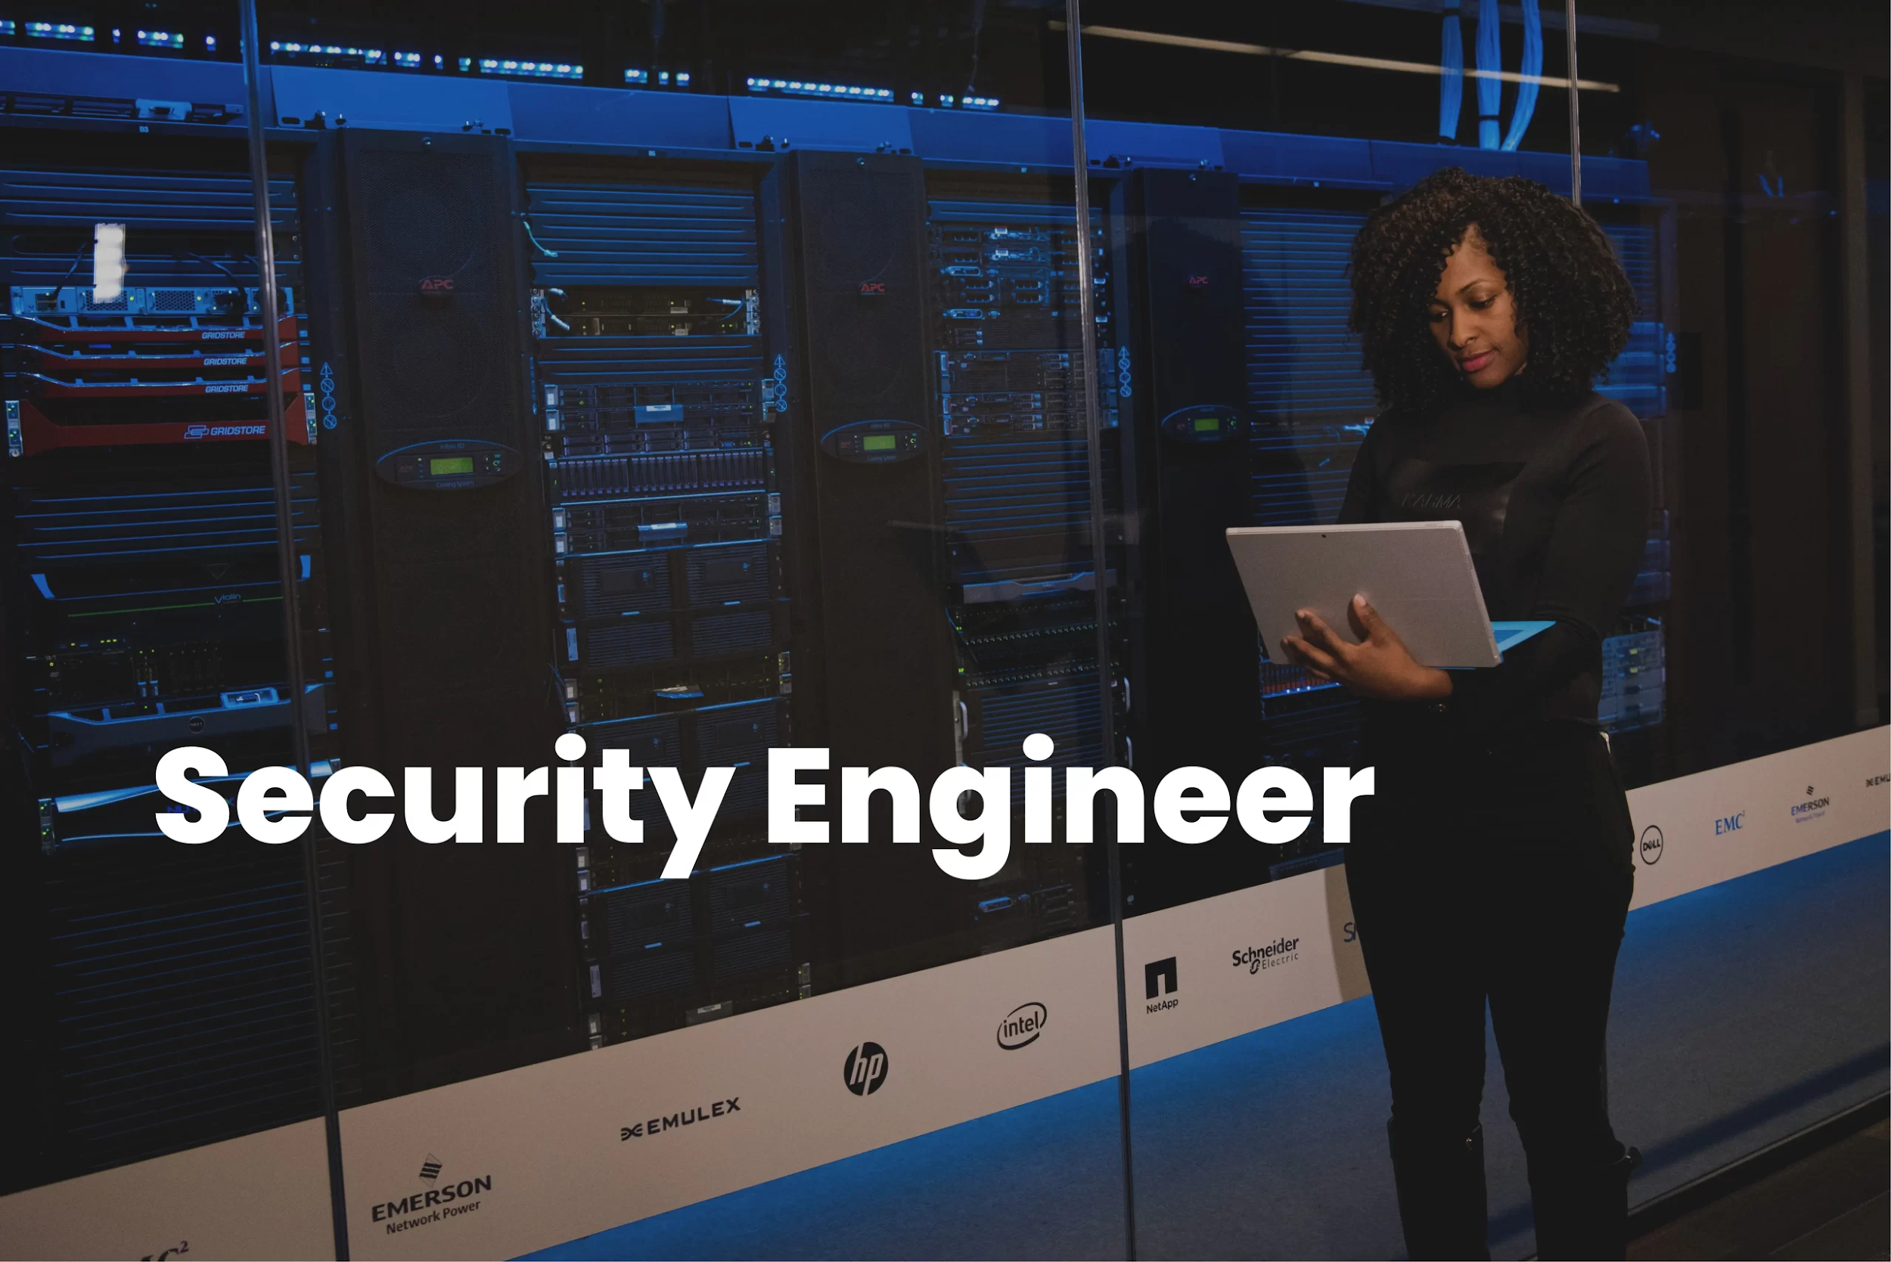
Personas
Information Security Engineer: Information security engineers oversee container security, conduct scans, configure security rules, manage vulnerability databases, and address threats to meet security standards.
Goals: Identify and mitigate vulnerabilities in containers effectively.
Pain Points: Handling evolving threats and managing vulnerability databases.

Slide 5
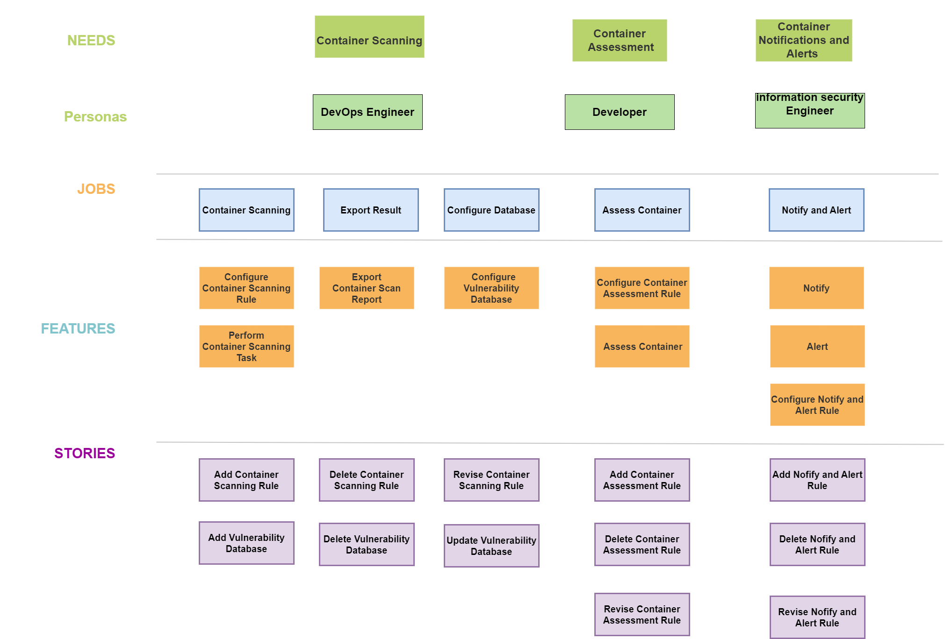
Storymap

Slide 6
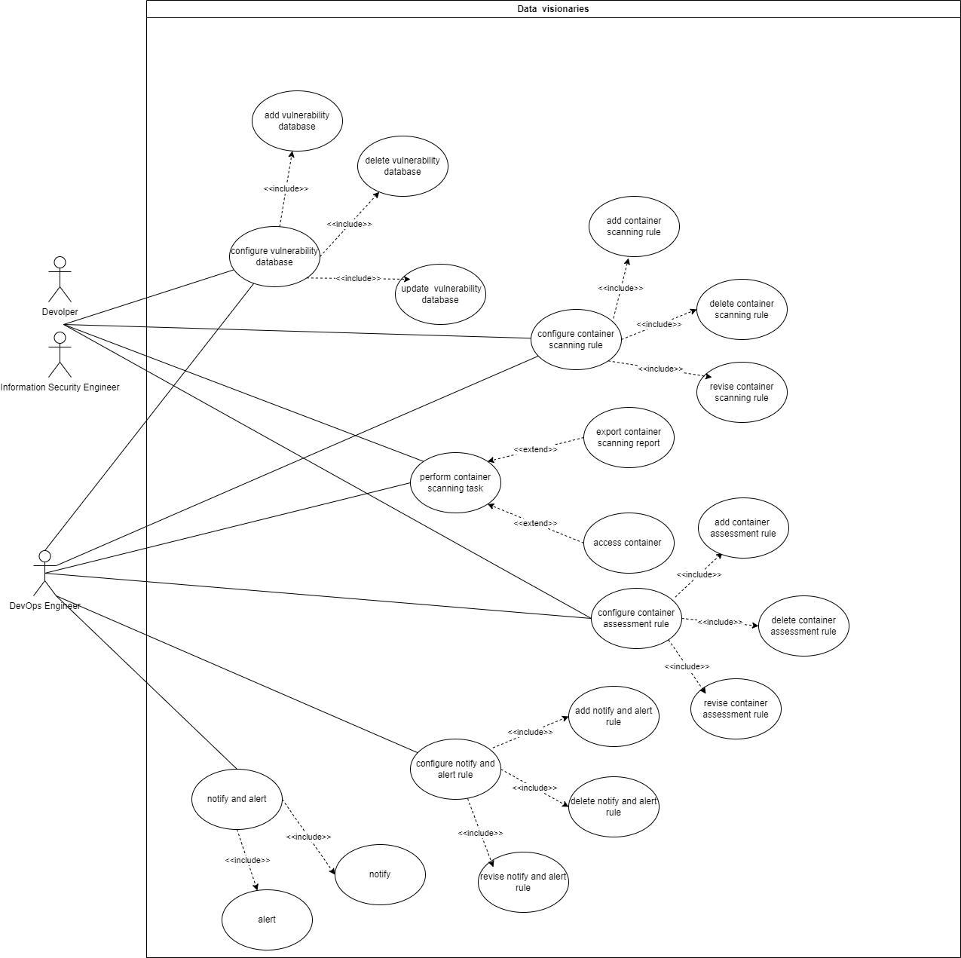
Use case diagram

Slide 7
Interaction analysis
Use Case | Cooperation Name | Used Roles | Candidate Classes that Play Them
001 - Add Container Scanning Rule | Configure Container Scanning Rule | DevOps Engineer, Information Security Engineer, | ContainerScanRule, ContainerRuleRepository
002 - Delete Container Scanning Rule | Configure Container Scanning Rule | DevOps Engineer, Information Security Engineer, | ContainerScanRule, ContainerRuleRepository
003 - Revise Container Scanning Rule | Configure Container Scanning Rule | DevOps Engineer, Information Security Engineer, | ContainerScanRule, ContainerRuleRepository
004 - Perform Container Scanning Task | Perform Container Scanning Tasks | DevOps Engineer, Information Security Engineer, | ScanTask, ScanningService, Container
005 - Assess Container | Assess Container | DevOps Engineer, Information Security Engineer, Developer | AssessmentRule, ScanResult, Container
006 - Add Container Assessment Rule | Configure Container Assessment Rules | DevOps Engineer, Information Security Engineer, Developer | AssessmentRule
007 - Delete Container Assessment Rule | Configure Container Assessment Rules | DevOps Engineer, Information Security Engineer, Developer | AssessmentRule
008 - Revise Container Assessment Rule | Configure Container Assessment Rules | DevOps Engineer, Information Security Engineer, Developer | AssessmentRule
009 - Export Container Scan Report | Export Container Scan Reports | DevOps Engineer, Information Security Engineer, Developer | ScanTask, ScanResult, ScanningService
010 - Notify | Notify and Alert | DevOps Engineer, Information Security Engineer | AlertService, AuditLog, Person
011 - Alert | Notify and Alert | DevOps Engineer, Information Security Engineer | AlertService, AuditLog, Person
012 - Add Notify or Alert Rule | Configure Notify and Alert Rule | DevOps Engineer, Information Security Engineer | AlertService, AuditLog
013 - Delete Notify and Alert Rule | Configure Notify and Alert Rule | DevOps Engineer, Information Security Engineer | AlertService, AuditLog
014 - Revise Notify and Alert Rule | Configure Notify and Alert Rule | DevOps Engineer, Information Security Engineer | AlertService, AuditLog
015 - Add Vulnerability Database | Configure Vulnerability Database | DevOps Engineer, Information Security Engineer, Developer | VulnerabilityDatabase, VulnerabilityDatabaseRepository
016 - Delete Vulnerability Database | Configure Vulnerability Database | DevOps Engineer, Information Security Engineer, Developer | VulnerabilityDatabase, VulnerabilityDatabaseRepository
017 - Update Vulnerability Database | Configure Vulnerability Database | DevOps Engineer, Information Security Engineer, Developer | VulnerabilityDatabase, VulnerabilityDatabaseRepository

Slide 8
SIAOUT

Slide 9
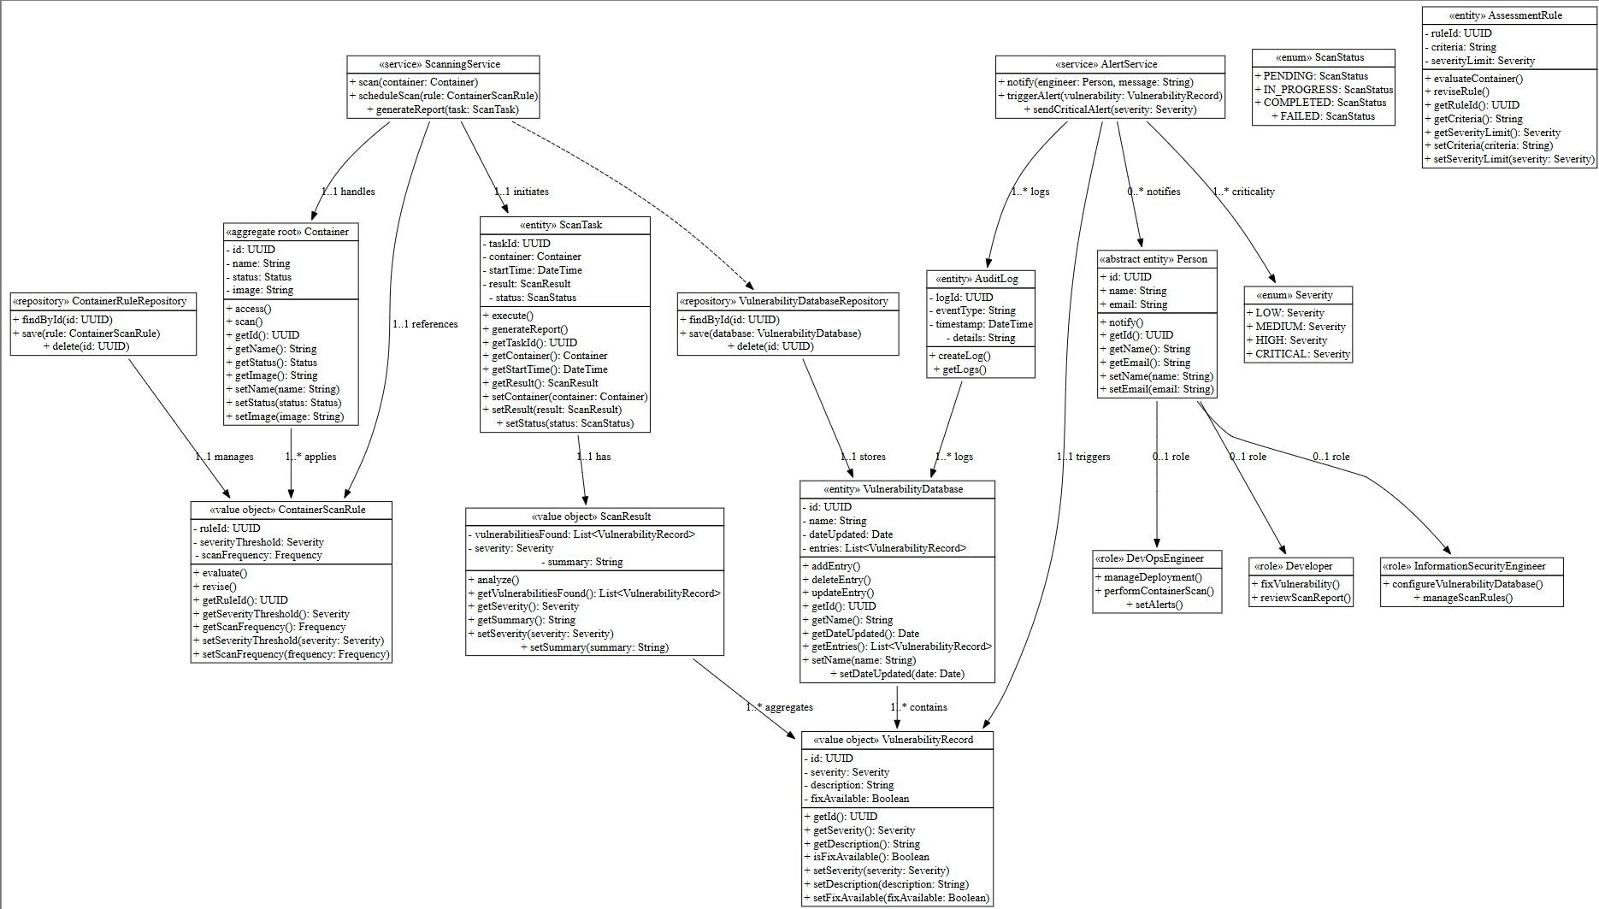
Final class diagram

Slide 10
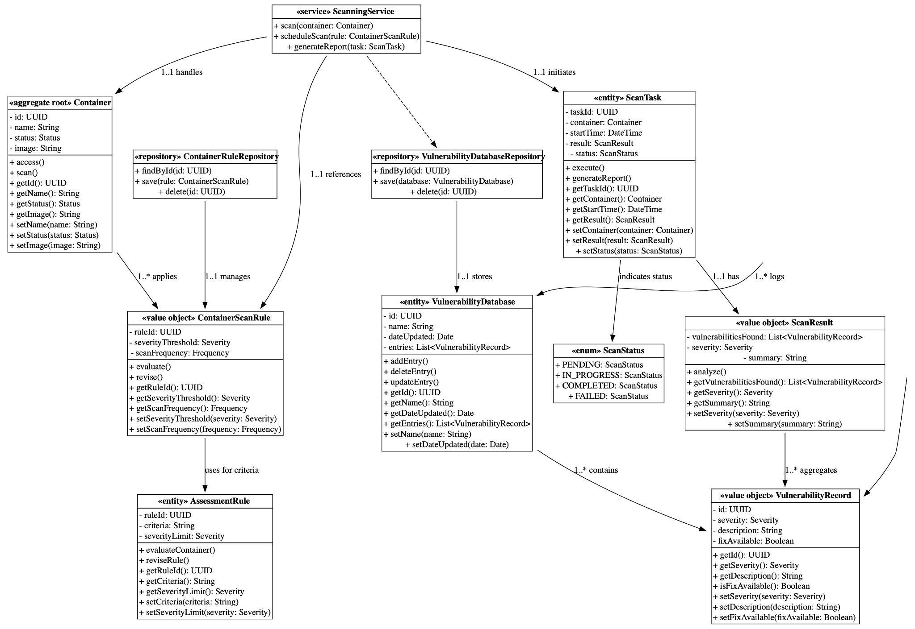
Final class diagram
left branch

Slide 11
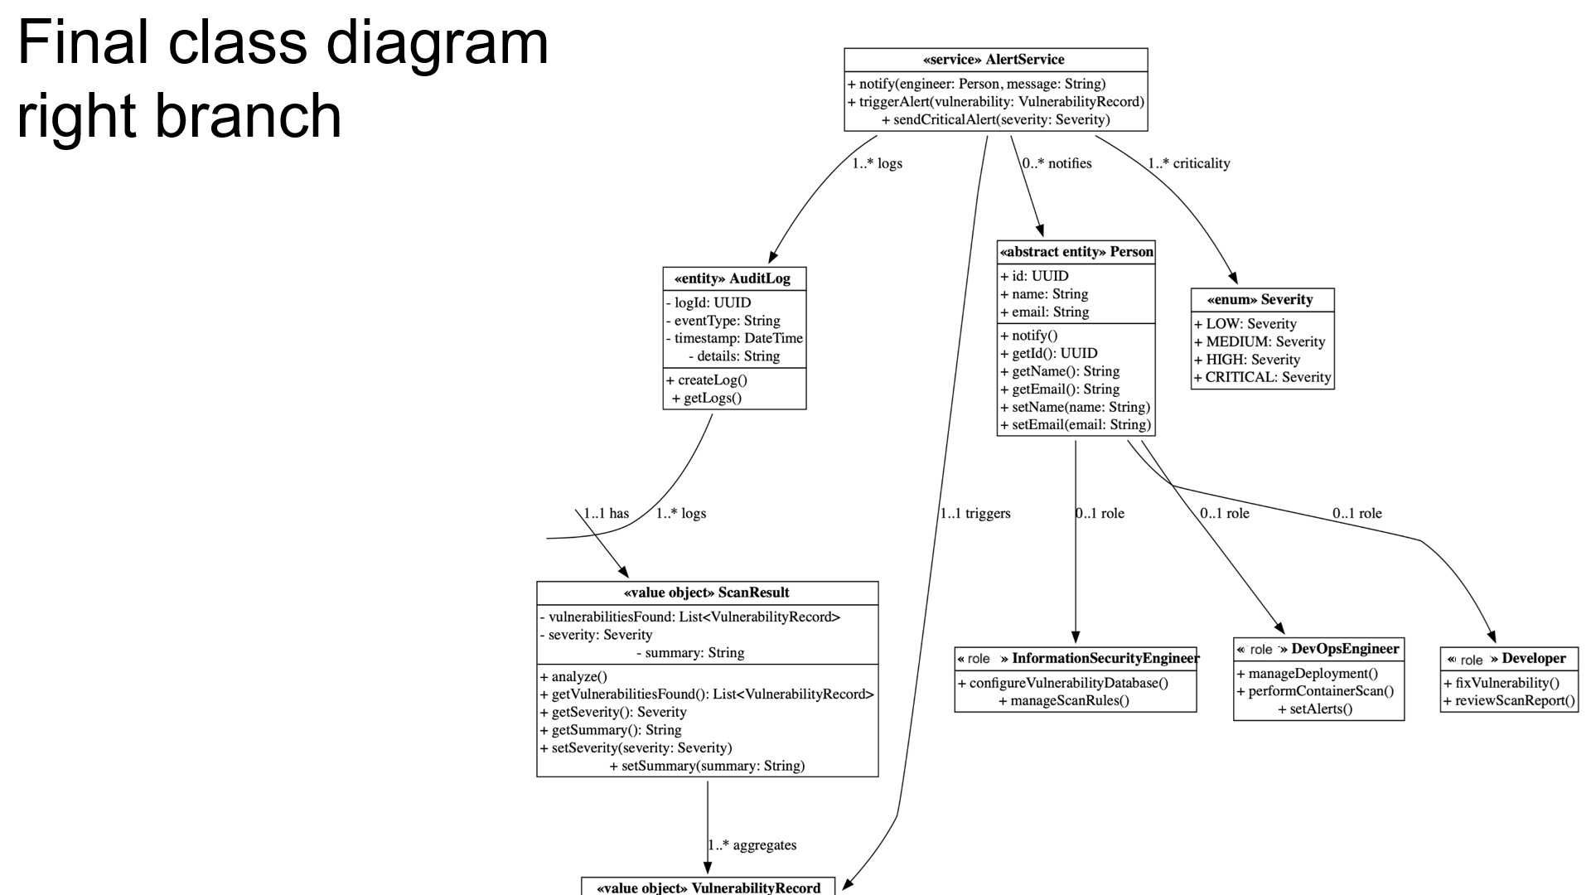
Final class diagram
right branch

Slide 12
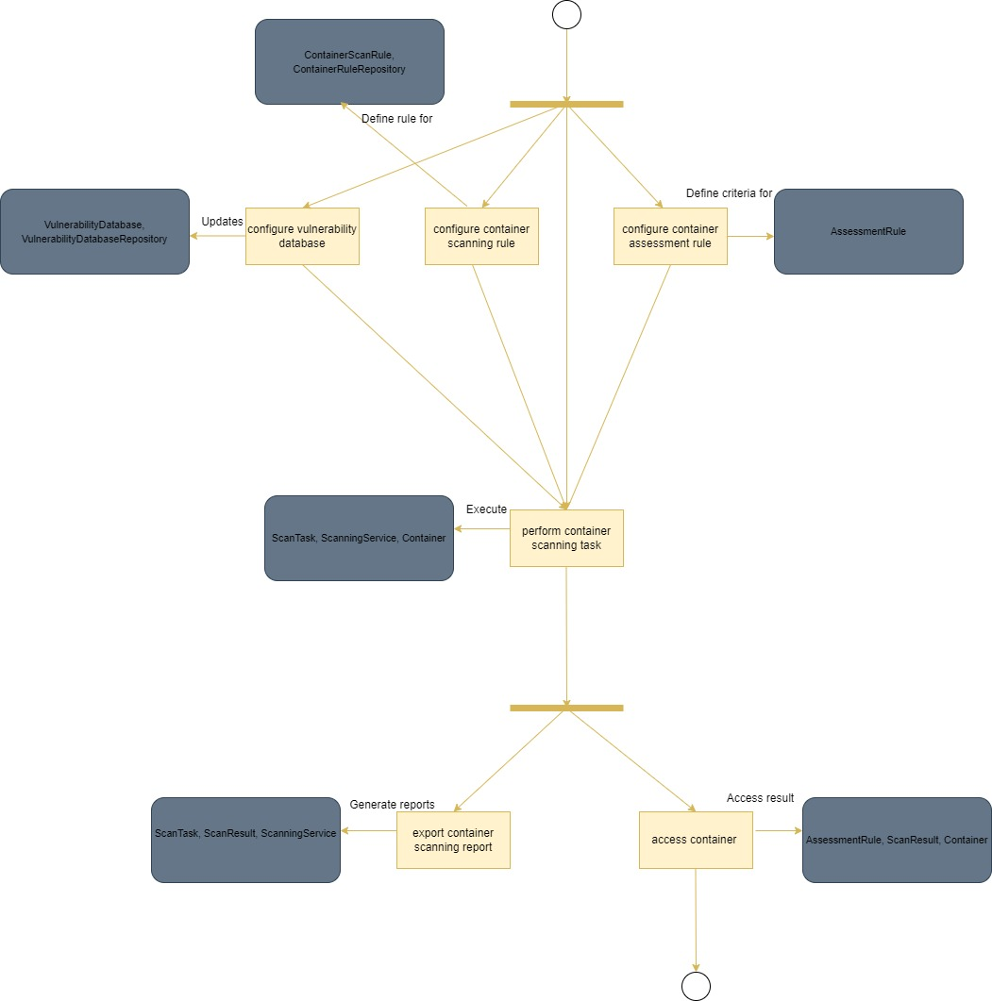
Detailed behavior
Developer and Information Security Engineer

Slide 13
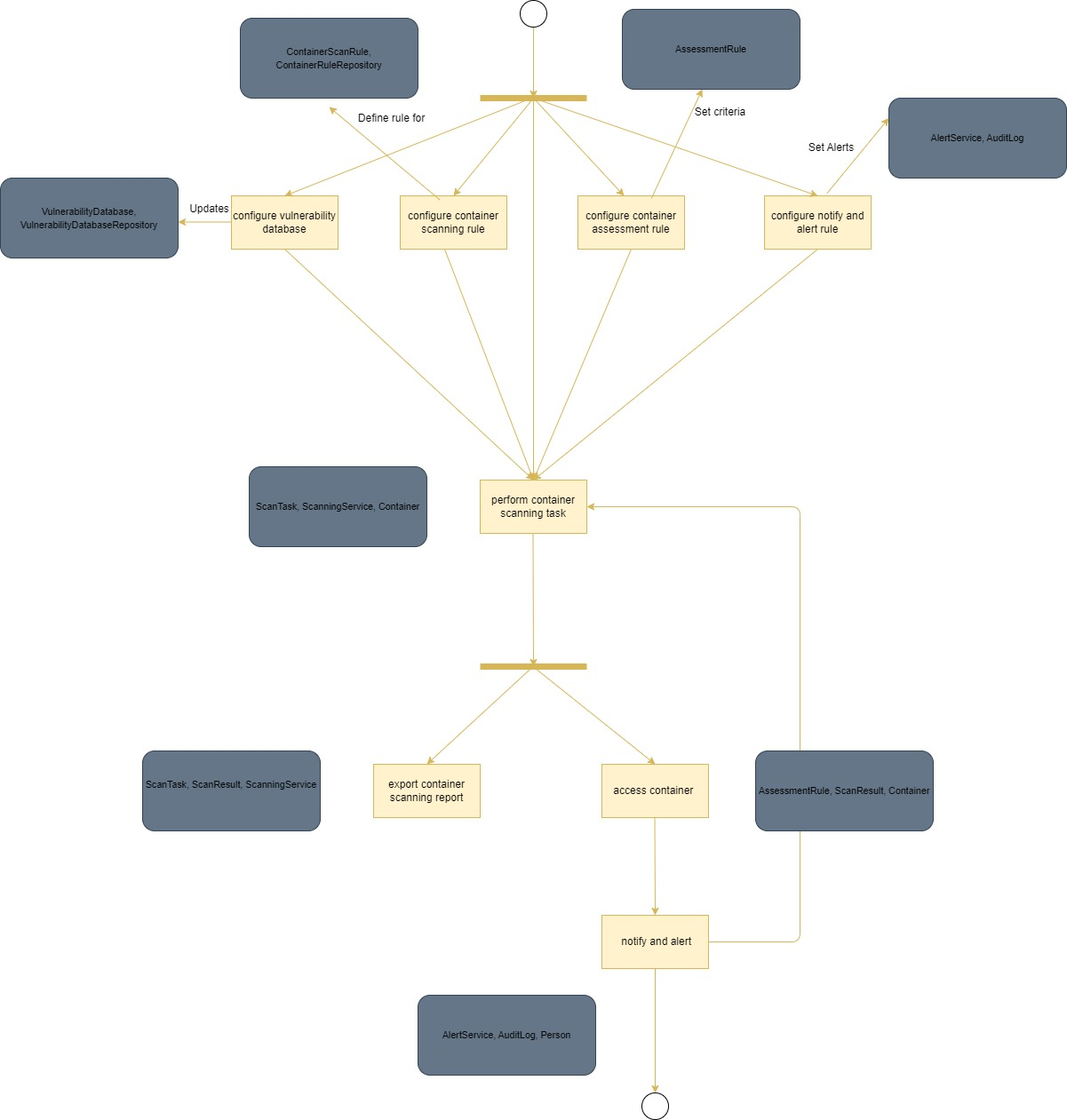
Detailed behavior
DevOps Engineer

Slide 14
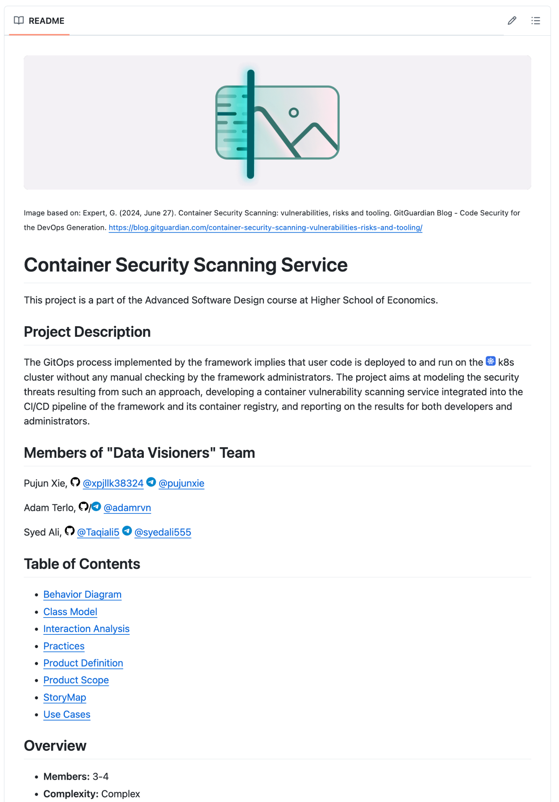
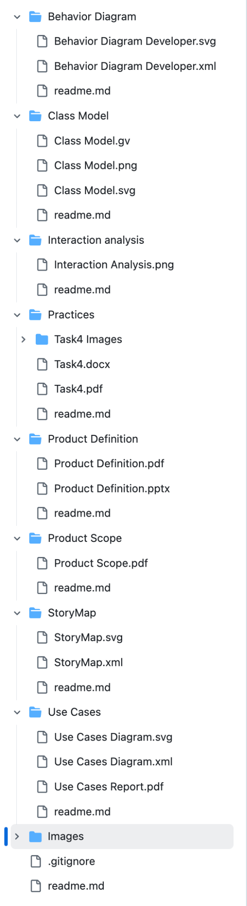
Repository structure

Slide 15



Team and roles
Full name: Pujun Xie
Telegram: @pujunxie
use cases, use cases diagram, behavior diagram
Full name: Adam Terlo
Telegram: @adamrvn
class diagram, interaction analysis, project structure
Full name: Syed Ali
Telegram: @syedali555
product description, personas, storymap

Slide 16
Thanks for listening.

